Slide 1

---------------
DATA ANALYST AND ANALYTICS INTERNSHIP
UNIFIED MENTOR BATCH (SEP 2024 – NOV 2024)
Presented by -
K. SAKIR AHMED (UMIP21647)

Slide 2
-
DATA ANALYST AND ANALYTICS INTERNSHIP
DESCLAIMER
This presentation explains the steps and processes I have done to complete my internship at Unified Mentor Pvt Ltd as a Data Analyst intern for two months
The datasets I used are taken from the links they provided in the sample pdfs they had sent me.
This presentation not only contains the results but all the processes involved to get them. You might be reading a lot of text paragraphs.
This presentation is to be viewed by ‘playing’ the presentation as every slide and every letter is animated. If you view the presentation normally, You wont find any paragraphs as they are hidden and would reveal itself when played.
Most slides are designed to take only one click for revealing contents. However, some slides may require multiple clicks as they are meant for explaining the steps.
UNIFIED MENTOR BATCH (SEP 2024 – NOV 2024)
Presented by -
K. SAKIR AHMED (UMIP21647)

Slide 3
-
DATA ANALYST AND ANALYTICS INTERNSHIP
PROJECTS SUBMITTED:
1. SUPERMART GROCERY SALES ANALYSIS
2. COMPANIES VALUATION ANALYSIS
3. MOVIE RECOMMENDER SYSTEMS
Note: I had to submit three projects since I took the internship for two months.
Presented by -
K. SAKIR AHMED (UMIP21647)

Slide 4
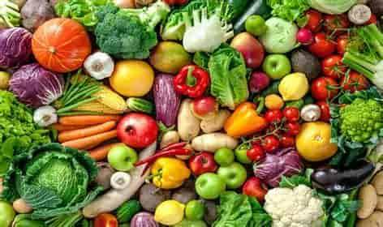
DATA ANALYST AND ANALYTICS INTERNSHIP
PROJECTS SUBMITTED:
1. SUPERMART GROCERY SALES ANALYSIS
This project primarily focuses on the sales of grocery products from a Supermart store for a period of 4 years. The objectives of the project are:
Import the dataset and perform data cleaning on the dataset.
Check the data for missing values and handle the null values efficiently.
Perform Exploratory Data Analysis (EDA) over the dataset to find insights in the dataset.
Use various Data Visualization techniques to properly convey the insights and analysis.
Use Machine Learning (ML) techniques and train the ML model to predict the sales and profit for the upcoming years.
2. COMPANIES VALUATION ANALYSIS
3. MOVIE RECOMMENDER SYSTEMS

Slide 5
1. SUPERMART GROCERY SALES ANALYSIS
ABOUT THE DATASET
The dataset contains about 9994 rows of sales transactions of grocery items in a Supermart store.
The data must be processed assuming all the sales is done on Tamil Nadu state. No other state is mentioned in the dataset.
The dataset mostly contains no null values. So it is easy to evaluate and prepare the data for further processing.
The data of sales range from Jan 2015 to Dec 2018 for 4 consecutive years.
This is a fictional data and hence making conclusions with the actual knowledge would be inappropriate. The conclusions drawn in this project are solely data-driven only.

Slide 6
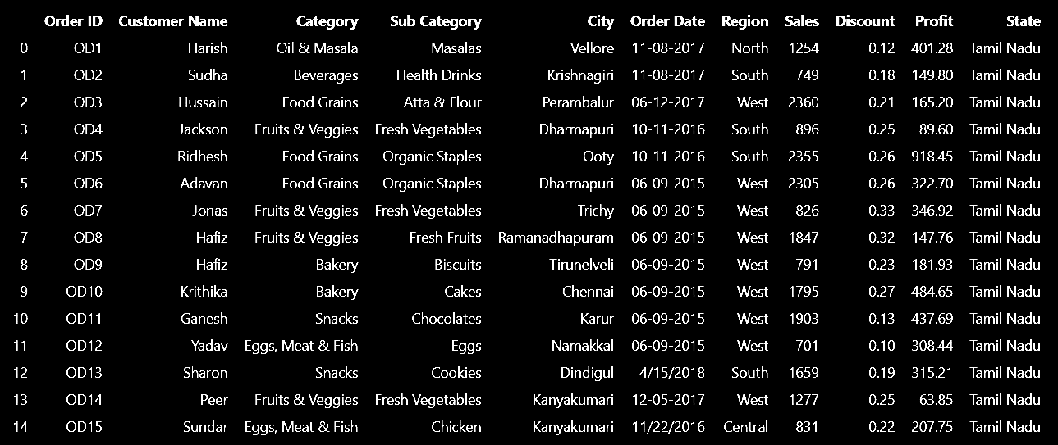
1. SUPERMART GROCERY SALES ANALYSIS
SNIP OF THE DATASET

Slide 7
1. SUPERMART GROCERY SALES ANALYSIS
USED TECHNIQUES AND TOOLS
Jupyter Notebooks
Python
Pandas
numpy
Power BI
Python
Matplotlib
Seaborn
Data Cleaning
Data Visualization
Machine Learning
Feature Engineering
Python
LinearRegression
Scikit-Learn
Python
StandardScaler
Train_test_split
LabelEncoder

Slide 8
1. SUPERMART GROCERY SALES ANALYSIS >
USED TECHNIQUES AND TOOLS
DATA CLEANING
Importing the dataset using pandas function pd.read_csv.
Checking if there are any null values in the database using df.isnull().sum() function.
Removing the duplicates using the df.drop_duplicates() function.
Removing the nulls in the database using the df.dropna() function or df.fillna() function.
Changing the Customer name column to ‘title’ format using the str.title() function.
Replacing slashes ( / ) in the order date column to hyphens ( - ) and converting the column into ‘datetime’ datatype using pd.to_datetime() function.
Extract the month, quarter of year and day from the column using dt.year(), dt.month() and dt.quarter() for convenient ML processing.

Slide 9
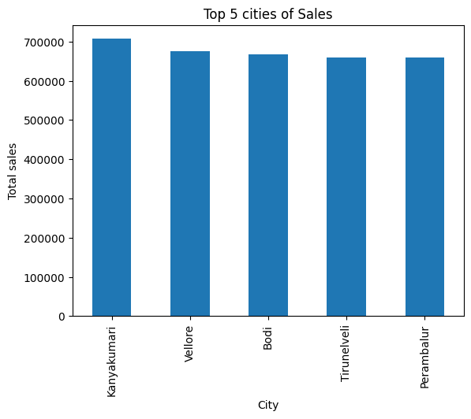
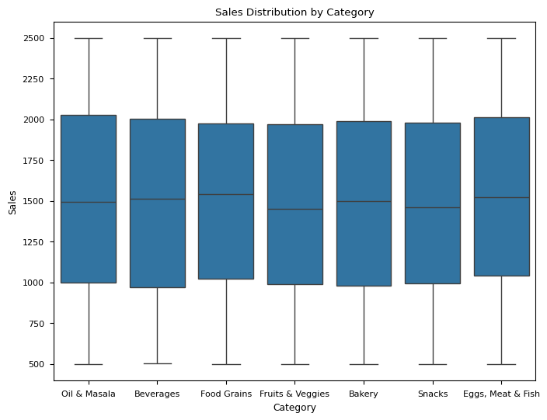
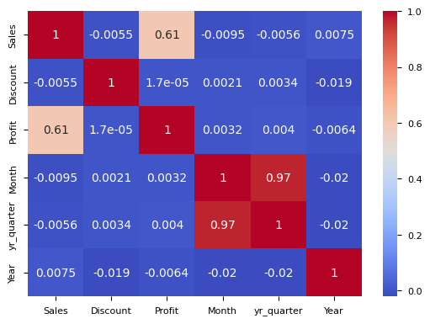
1. SUPERMART GROCERY SALES ANALYSIS
> USED TECHNIQUES AND TOOLS
DATA VISUALIZATION – using python
The top 5 cities are plotted out in a bar chart using matplotlib
The top cities were Kanyakumari,
Vellore, Bodi, Thirunelveli, Perambur.
This boxplot shows that the sales were good for beverages, Oil and masala, and other meat items.
This heatmap is created by seaborn and is useful to get the correlation for various categories,
We can see that the Sales and Profit columns are more related. Other columns are barely related or close to zero.

Slide 10
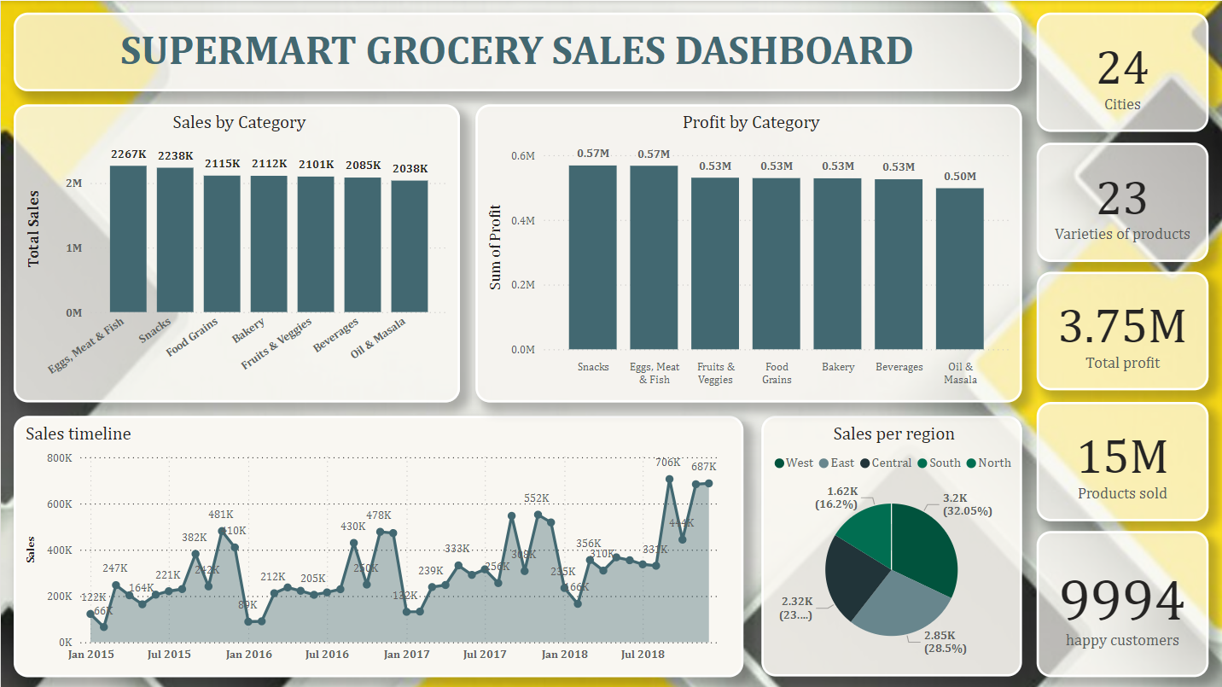
1. SUPERMART GROCERY SALES ANALYSIS
> USED TECHNIQUES AND TOOLS
DATA VISUALIZATION – using Power BI
The Dashboard was created using Microsoft Power BI. It was created for immediate recognition of sales insights and analysis.
It is an interactive dashboard, so we can focus on any particular value and get insights on them
We can immediately find that by selling products around 24 cities and serving over 23 different varieties of grocery products, they were able to make an overall profit of 3.75 Million and there were a total of 15 Million products sold.
We can also see that the sales had a considerable increase on the 2nd half of every year.

Slide 11
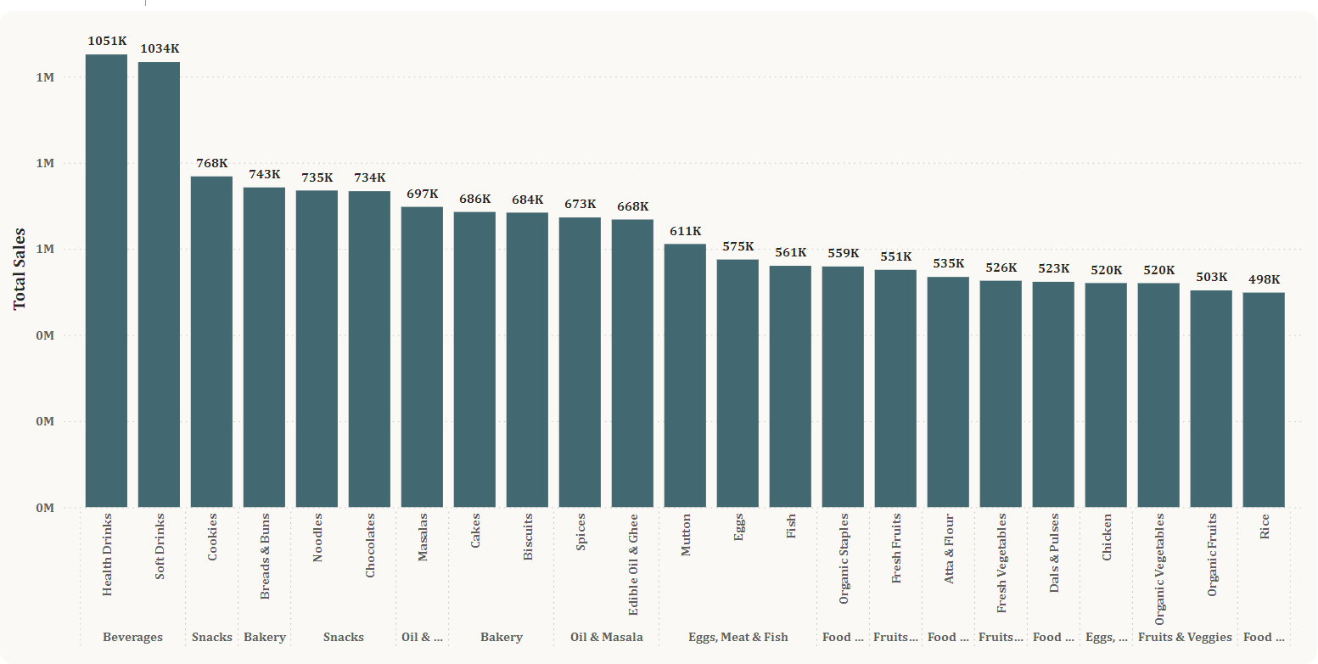
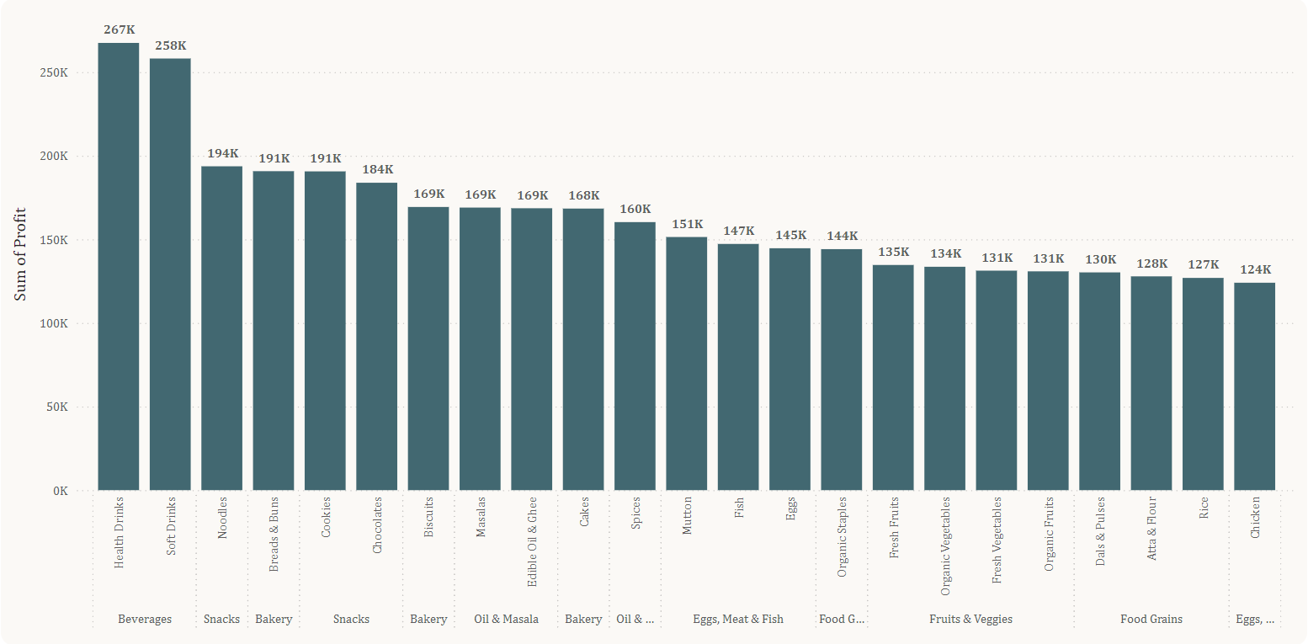
1. SUPERMART GROCERY SALES ANALYSIS
> USED TECHNIQUES AND TOOLS
DATA VISUALIZATION – using Power BI
This is the Sales chart. From this chart, we can conclude that:
Health drinks and soft drinks are the most selling products which constitute for about 2.1 million sold products combined.
Snacks and Bakery items take the second best selling products.
This is the Profits chart. From this chart, we can conclude that:
Beverages yield the most profit of about 530 Thousand (about 14.03 %) by itself (Health and soft drinks)
Snacks category has constituted about 15.16 % of the total profit when combined (noodles, cookies & chocolates)

Slide 12
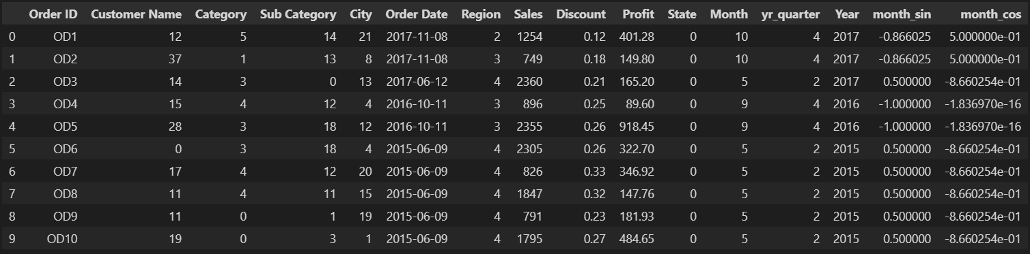
1. SUPERMART GROCERY SALES ANALYSIS
> USED TECHNIQUES AND TOOLS
FEATURE ENGINEERING – Label encoding
For the machine to learn from the data properly, We must convert the categorical values into numerical values.
The python function LabelEncoder() makes it easy to convert the categorical values into numeric values.
I also included the Cyclic values (sin and cos) for months for even better understanding of repeating cycles.
This is the snip of the database after encoding with numeric values.

Slide 13
1. SUPERMART GROCERY SALES ANALYSIS
> USED TECHNIQUES AND TOOLS
FEATURE ENGINEERING – Data Pre-processing
Now, the data must be split into training and testing sets for machine learning.
I used the python function train_test_split() from scikit-learn library to make this process convenient for me. The train_test_split() function splits the data based on our input.
We usually select the most relatable columns as features. Columns like State, order date, order ID are all removed from the features set as it may affect the quality of machine learning algorithm.
We set the target variable that must be predicted by the ML algorithm.
Next, we perform feature scaling on the data to bring all the values between 0 and 1. This makes the predictions more accurate.
The python function StandardScaler() is used to feature scale the database.

Slide 14
1. SUPERMART GROCERY SALES ANALYSIS
> USED TECHNIQUES AND TOOLS
MACHINE LEARNING
The steps used for performing Machine Learning are:
Import the Machine Learning algorithm from the scikit-learn library
I used the Linear regression model to predict the value of sales and profits.
The models are trained using the fit_transform() method of the LinearRegression() model
Then we predict the values using predict() function of the model
The values are then plotted against the actual sales values using a scatter plot from matplotlib library.
The same steps are followed for predicting the profit values of the sales database.
The outputs are presented in the next slide

Slide 15
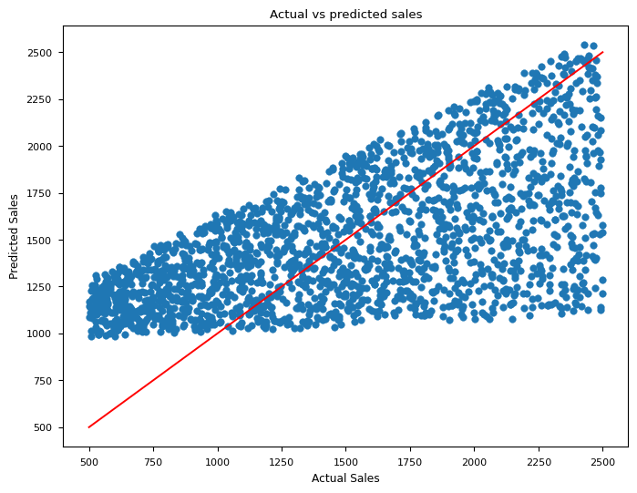
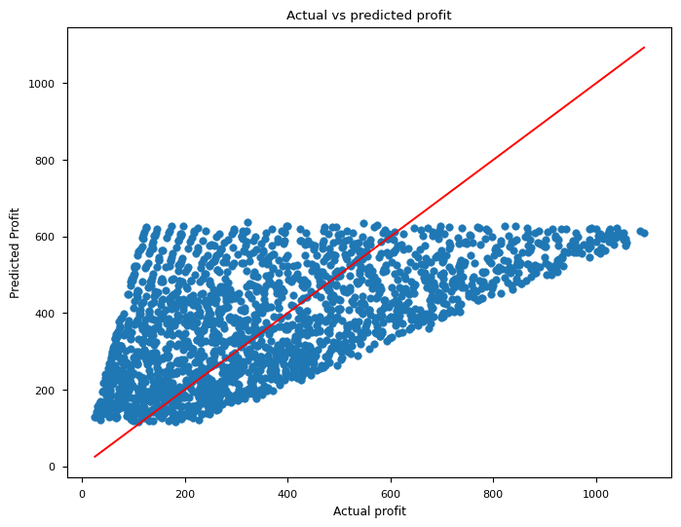
1. SUPERMART GROCERY SALES ANALYSIS
> USED TECHNIQUES AND TOOLS
MACHINE LEARNING – Plotting the predictions
The predictions are very different yet they are projected around the red line, which is a good sign.
The unexpected predictions are mainly due to random data entered in the dataset

Slide 16
DATA ANALYST AND ANALYTICS INTERNSHIP
PROJECTS SUBMITTED:
1. SUPERMART GROCERY SALES ANALYSIS
> USED TECHNIQUES AND TOOLS
Resources and references
The step by step process of this project is uploaded on my github page. Feel free to visit and check it.
The repository contains the original dataset along with the excel files I had exported and a power BI file.
Most of the techniques I used were learnt from the Unified Mentor project pdf file
The Supermart Sales Reports Github repository link: click here to view the repository
2. COMPANIES VALUATION ANALYSIS
3. MOVIE RECOMMENDER SYSTEMS

Slide 17
DATA ANALYST AND ANALYTICS INTERNSHIP
PROJECTS SUBMITTED:
1. SUPERMART GROCERY SALES ANALYSIS
2. COMPANIES VALUATION ANALYSIS
3. MOVIE RECOMMENDER SYSTEMS

Slide 18

DATA ANALYST AND ANALYTICS INTERNSHIP
PROJECTS SUBMITTED:
1. SUPERMART GROCERY SALES ANALYSIS
2. COMPANIES VALUATION ANALYSIS
The Objective of this project is to clean, analyze and report the valuation of different companies and their values through different visualization techniques. Some of the major objectives are
Import the dataset and perform data cleaning on the dataset.
Check the data for missing values and handle the null values efficiently.
Perform Exploratory Data Analysis (EDA) over the dataset to find insights in the dataset.
Use various Data Visualization techniques to properly convey the insights and analysis.
3. MOVIE RECOMMENDER SYSTEMS

Slide 19
2. COMPANIES VALUATION ANALYSIS
ABOUT THE DATASET
After removing the duplicates from the dataset, I observed that it had information of about 1185 different companies.
There were 7 columns including the ‘valuation’ column which was not entered as numerical data but as an objective data. It must be changed.
And I also noticed that the column name ‘City’ was displayed as ‘City\Xa0’ which made the selection of that particular column impossible for me. I had to change that too.
And there were about 18 rows in which the values were improperly entered. Every value was entered in its next column. I will show you the problem in the data cleaning section
The Investors names are given in lists, which can be processed to find out individual investors’ total number of investments.

Slide 20
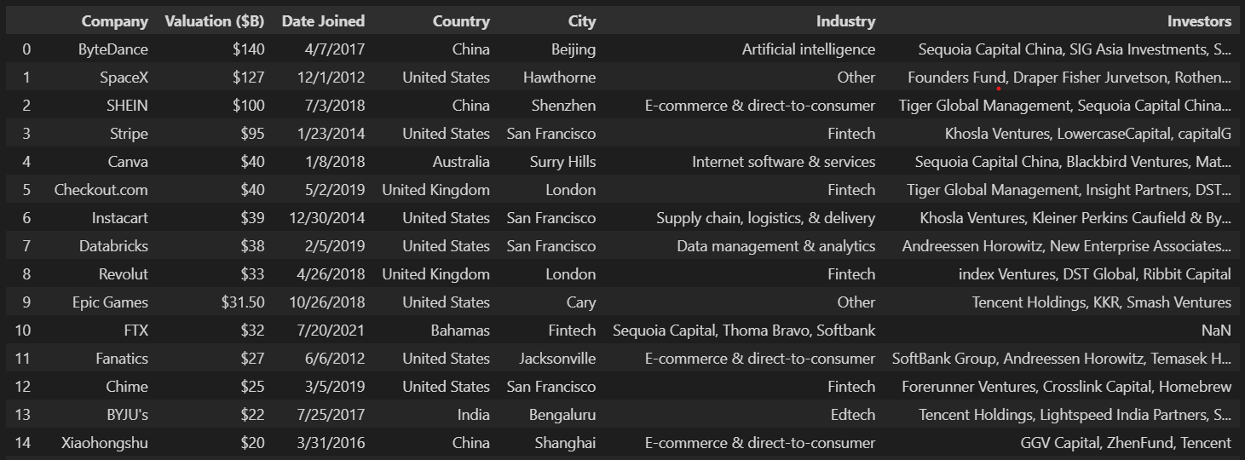
2. COMPANIES VALUATION ANALYSIS
SNIP OF THE DATASET
As I said earlier, you can notice the values have been entered improperly in index no: 10. The industry “Fintech” is entered into the City column.
We have to move the values to the next columns in the database
The column title ‘City\Xa0’ appears internally and disappears when we view the dataframe.

Slide 21
2. COMPANIES VALUATION ANALYSIS
TOOLS AND TECHNIQUES
DATA
CLEANING
Python
Used Libraries
Numpy
Pandas
DATA
VISUALIZATION
Python
Used Libraries
Matplotlib
seaborn

Slide 22
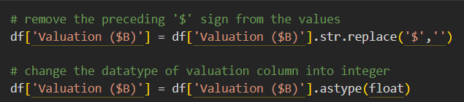
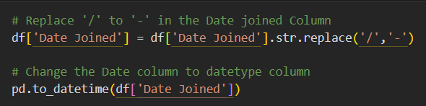
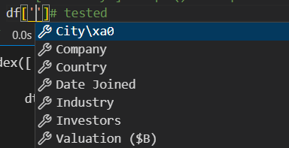
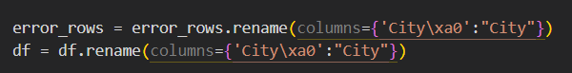
2. COMPANIES VALUATION ANALYSIS >
TOOLS AND TECHNIQUES
DATA CLEANING
Data cleaning is the biggest objective in this particular dataset.
The first thing is to change the datatype of some columns. The ‘Valuation (B$)’ column must be changed into numeric datatype
The second step is to change the “Date Joined“ column into proper format and then change the datatype into datetime format.
We use the pandas function ‘to_datetime()’ to convert into datetime format
Another problem I faced with is the ‘City’ column had a string ‘\Xa0’ trailing. The value cannot be seen normally. Thanks to the VSCode IntelliSense due to which I corrected the error.
I used pd.rename() function to rename the column into a proper name.
The next thing needed to be cleaned was the improper entry of values which I said earlier. I will step into the details on the next slide.

Slide 23
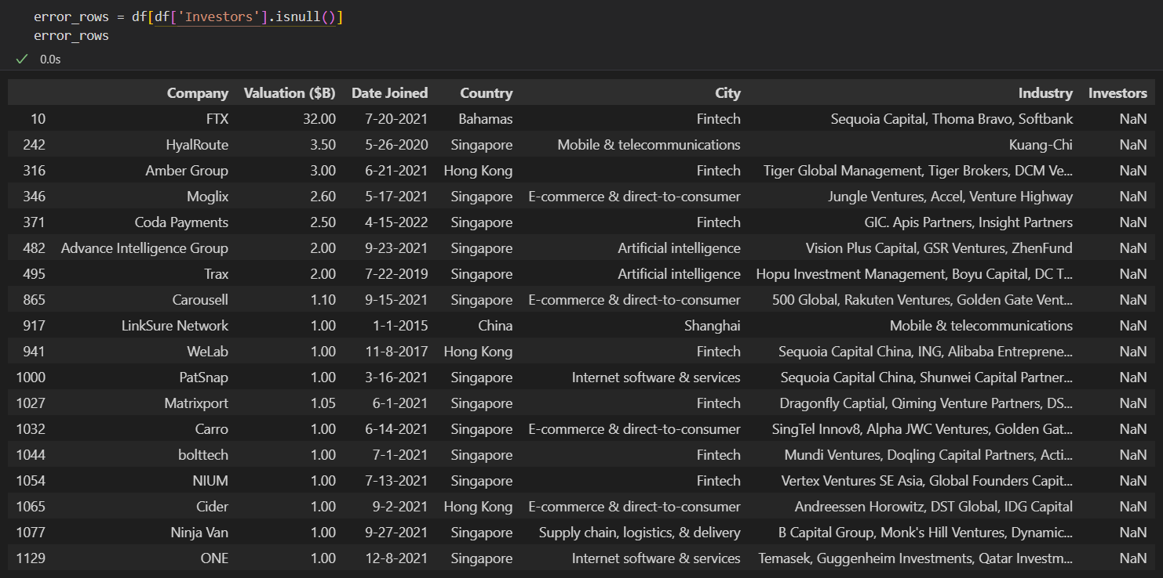
2. COMPANIES VALUATION ANALYSIS >
TOOLS AND TECHNIQUES
DATA CLEANING
First I identified that the ‘Investors’ Column has 18 null values in it. So I only selected those values and saved them into a new variable
This is the 18 rows of improperly filled values. One simple solution is to move the values from one column into the other

Slide 24
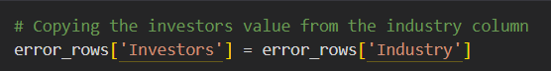
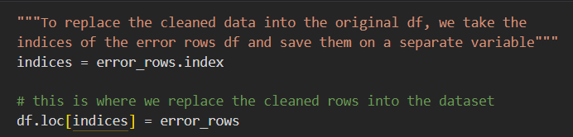
2. COMPANIES VALUATION ANALYSIS >
TOOLS AND TECHNIQUES
DATA CLEANING
First I identified that the ‘Investors’ Column has 18 null values in it. So I only selected those values and saved them into a new variable
So, I moved each column values into the next column values. Simple column – column transfer.
Now that the columns are modified properly, I used “fillna()” command to fill the null values in the dataset
There were actually 17 “City” rows and an “Investor” row with null values
Then I replaced the values of the original table with the modified table using the indices. I collected all the modified rows’ indices and saved them in a variable.
Then I used iloc() to enter specific values into the respective rows

Slide 25
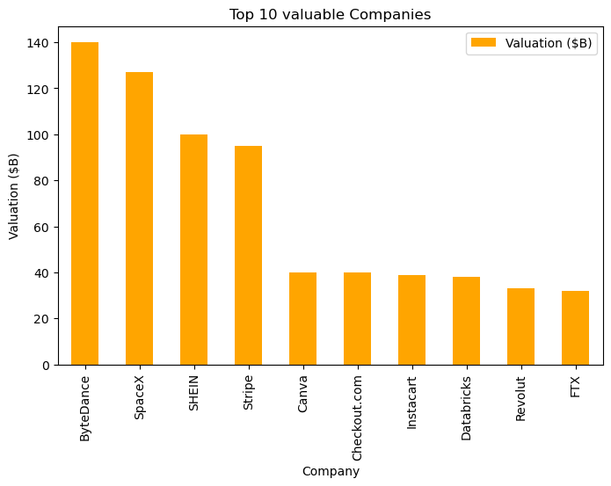
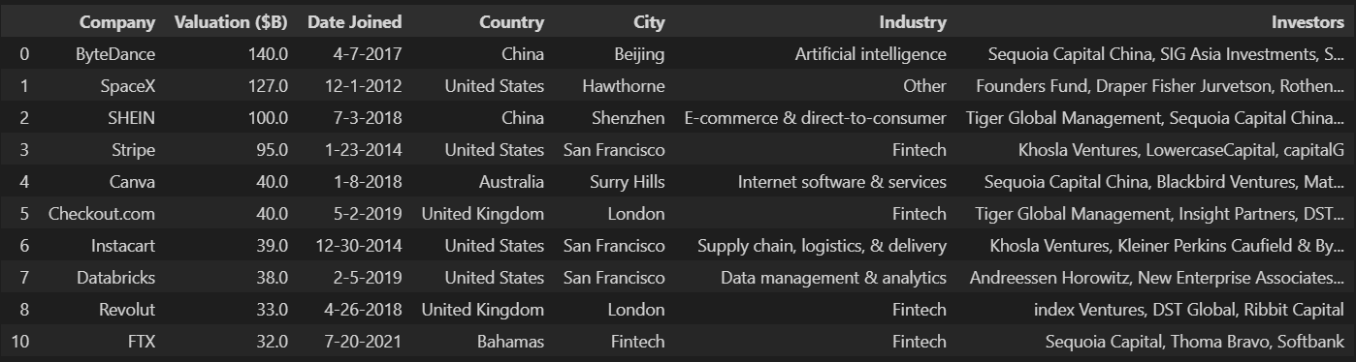
2. COMPANIES VALUATION ANALYSIS >
TOOLS AND TECHNIQUES
DATA VISUALIZATION
Top !0 Valuable Companies
The top 10 valuable companies are plotted using matplotlib and seaborn.
Some of the companies include ByteDance, SpaceX, Stripe, Canva and so on
We can also find that FTX is one of the latest companies to reach a huge valuation in 3 years (from 2021)

Slide 26
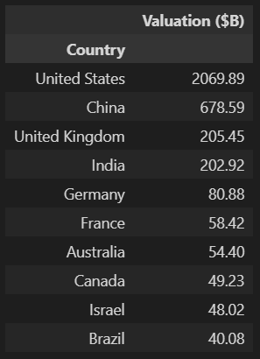
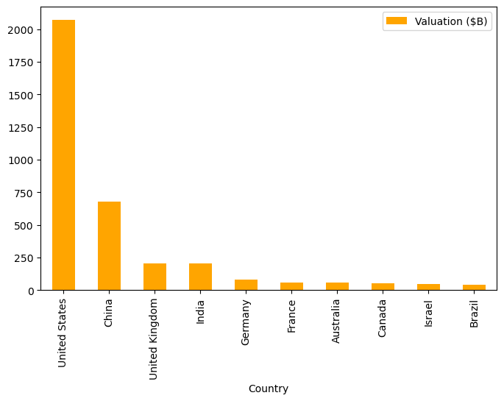
2. COMPANIES VALUATION ANALYSIS >
TOOLS AND TECHNIQUES
DATA VISUALIZATION
Top !0 Countries with highest Investments
China has more investments than the 3rd , 4th, and 5th countries all combined.
United States stands on the top of the list with three times as more investments as China
United kingdom and India are almost equal in terms of investments

Slide 27
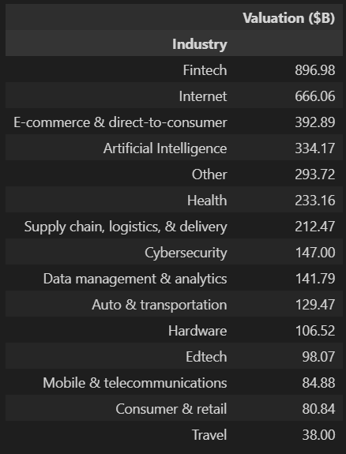
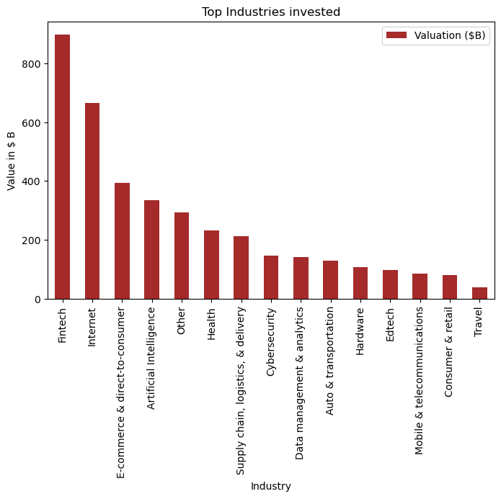
2. COMPANIES VALUATION ANALYSIS >
TOOLS AND TECHNIQUES
DATA VISUALIZATION
Top !0 Industries with highest Investments
The highest invested industry was the Fintech industry, with approximately 900 Billion dollars being invested in them.
Internet and software industry comes second with about 666 Billion dollars.
The most least invested industry is the travel industry.
Although Artificial intelligence is one of the emerging technologies, they were one of the most invested fields in the world

Slide 28
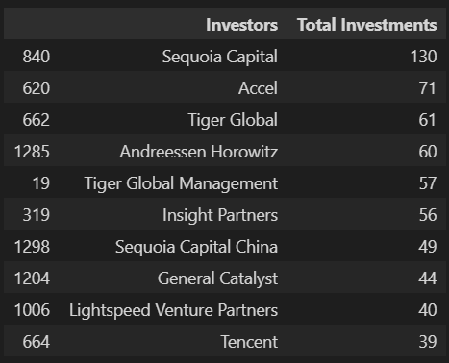
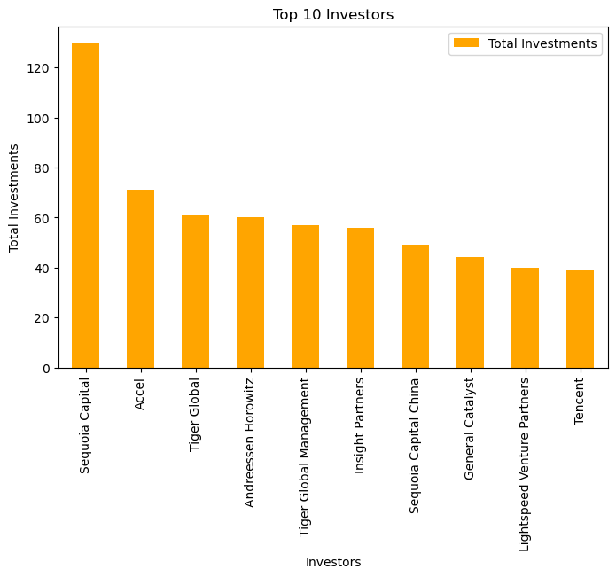
2. COMPANIES VALUATION ANALYSIS >
TOOLS AND TECHNIQUES
DATA VISUALIZATION
Top !0 investors with highest Investments
I created an empty set, ran two nested loops to count and populate the dictionary with the investors and their counts.
We can see that Sequoia Capital is the leading investor investing for about 130 unique companies in the world.
All the investors and their respective investments are listed separately in the project notebook and also in a separate excel file.
*Note that “Sequoia Capital” and “Sequoia capital China” are separate companies since Nov 2023

Slide 29
DATA ANALYST AND ANALYTICS INTERNSHIP
PROJECTS SUBMITTED:
1. SUPERMART GROCERY SALES ANALYSIS
2. COMPANIES VALUATION ANALYSIS
RESOURCES AND REFERENCES
All the code and the project is available in my github page. I will provide the link below.
The repository contains the original table ‘unicorns till sep 2022.csv’ along with the whole project file. I have also included the cleaned dataset in csv and excel formats for convenience.
The Companies Valuation project github repository link: click here to view the repository
3. MOVIE RECOMMENDER SYSTEM

Slide 30
DATA ANALYST AND ANALYTICS INTERNSHIP
PROJECTS SUBMITTED:
1. SUPERMART GROCERY SALES ANALYSIS
2. COMPANIES VALUATION ANALYSIS
3. MOVIE RECOMMENDER SYSTEM

Slide 31



DATA ANALYST AND ANALYTICS INTERNSHIP
PROJECTS SUBMITTED:
1. SUPERMART GROCERY SALES ANALYSIS
2. COMPANIES VALUATION ANALYSIS
3. MOVIE RECOMMENDER SYSTEM
The Movie recommender system recommends movies to the user based on their activity and their preferences. This project focuses on creating a movie recommender that uses the movie database to identify movies, and analyze the patterns in user’s rating preferences, to provide us with movies based on our choice.
These movie recommenders are greatly used in almost every streaming platform like Netflix, Amazon prime, Hotstar and so on.
And not only movies, every e-commerce platform, browsers and even hotel reservation services has these kind of recommenders to provide relatable and satisfactory results to the users
These Recommendation systems use complex statistical concepts and Machine Learning techniques for providing us with their results

Slide 32
3. MOVIE RECOMMENDER SYSTEM
ABOUT THE DATASET
The Movie Recommender system uses the MovieLens Dataset. The dataset created by the students of University of Minnesota. They provide datasets for research purposes and education. Initially, I thought of using the MovieLens 20M dataset. But it was too huge for my system to handle. So, I chose a smaller dataset to work
I had chosen to work with the educational dataset which contains movie information of about 9724 movies and their genres.
They also provide a ratings dataset which contains userId, movie_id, timestamp and the ratings of that movie given by that particular movie. The ratings dataset had about little more than 1,00,000 ratings in the movie set.
You can be assured that a given movie has atleast one rating in it. There are a total of 610 users in the ratings database.
In this project, I created a list of dataframes for different uses. It was a bit complex but, I did manage to do it.

Slide 33
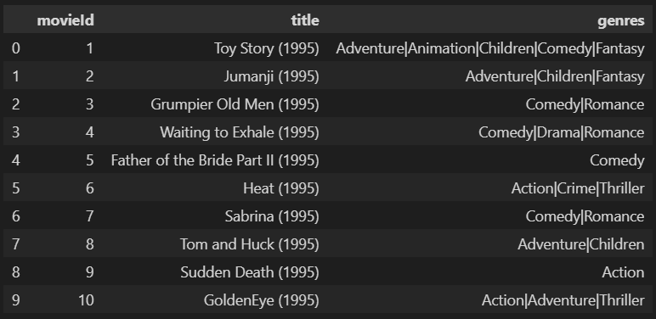
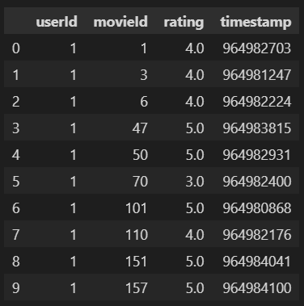
3. MOVIE RECOMMENDER SYSTEM
SNIP OF THE DATASET
We have two dataframes that we are gonna use. One is the “Movies_df” and another is the “Ratings_df”.
Movies df
Ratings df

Slide 34
3. MOVIE RECOMMENDER SYSTEM
TOOLS AND TECHNIQUES
DATA CLEANING
EXPLORATORY DATA ANALYSIS
Python modules:
Numpy
Pandas
Python modules:
Matplotlib
Seaborn
Counter
DATA PRE-PROCESSING
BUILDING THE RECOMMENDER SYSTEM
Python modules:
Scikit-learn
Scipy.csr_matrix
Cosine_similarity
Python modules:
Scikit-learn
Kneighbors
fuzzywuzzy

Slide 35
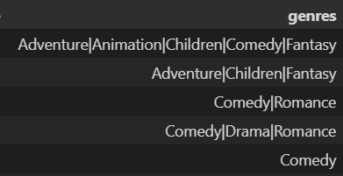
3. MOVIE RECOMMENDER SYSTEM
>
TOOLS AND TECHNIQUES
DATA CLEANING
Actually the dataset was pretty clean at the start. I just changed one or two columns.
For the movies dataset, it was clean. But the genres column was entered as a string separated by a “|” symbol instead of a list of movie genres.
So, I used the split() function to create it into a list.
And for the ratings dataset, I first thought of changing the timestamp column into proper date format. But later I realized we won’t be using that values in our recommendation system. So I didn’t change it.
I also used the drop_duplicates function to check and remove the duplicates. But there was no duplicates in the dataset and also there were no null values in the dataset.

Slide 36
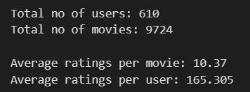
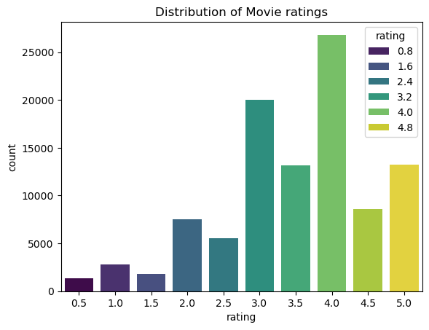
3. MOVIE RECOMMENDER SYSTEM
>
TOOLS AND TECHNIQUES
EXPLORATORY DATA ANALYSIS
There was not much to visualize in this dataset. But we can find the best and worst rated movies or….most rated movies and least rated movies…and so on.
The total no of users and movies rated was found out using nunique() function
I found the distribution of ratings using seaborn’s countplot(). From which, I found that most reviews are positive
Every movie has an average rating of 3.502 and every user has rated an average of 3.66 ratings.
Now, according to this grouping, we can find the number of ratings per movie. And I found that
Forrest Gump,
The Shawshank Redemption and
The Pulp Fiction
are the top three movies with most ratings.

Slide 37

3. MOVIE RECOMMENDER SYSTEM
>
TOOLS AND TECHNIQUES
EXPLORATORY DATA ANALYSIS
Simple average rating
However, we cannot calculate the top rated movie (In terms of rating) using the simple average of ratings. It would be misleading. Here is why.
If a movie has an average rating of ‘4.3’ out of 300 ratings, you can conclude that it has been viewed by many people and has a genuine review
But, if another movie has rating of 5 out of only 3 ratings, you cannot be sure about the movie's goodness
That is, if a movie has only one 5 star rating, it would simply be the best movie out of everything.
A Bayesian Average is the proper solution for this. The Bayesian average gives the value to a movie based on the weight given to a rating.

Slide 38
3. MOVIE RECOMMENDER SYSTEM
>
TOOLS AND TECHNIQUES
EXPLORATORY DATA ANALYSIS
Bayesian average rating
The Bayesian average gives the rating to a movie considering the total ratings given to the movie, the ratings and the confidence value that you provide for the rating to be genuine.
Bayesian avg = C x M + (x1 + x2 + x3 + … + xn) / C + n
where,
C is the confidence value or expected value.
M is the prior mean
Xn is the sum of all the individual ratings of the movies
n is the no. of ratings of the given movie
After using the Bayesian average, Now we can find the top rated movies.

Slide 39
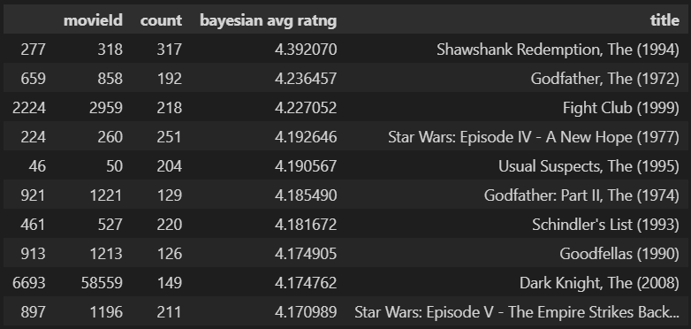
3. MOVIE RECOMMENDER SYSTEM
>
TOOLS AND TECHNIQUES
EXPLORATORY DATA ANALYSIS
Top 10 Movies
We merge the Bayesian values with the ratings dataframe and also the titles of movies from the movies dataframe. Now, the top 10 movies are
Of course this makes sense because all of these are famous movies till date.

Slide 40
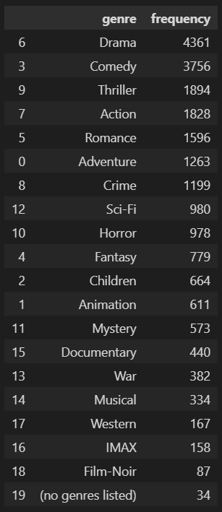
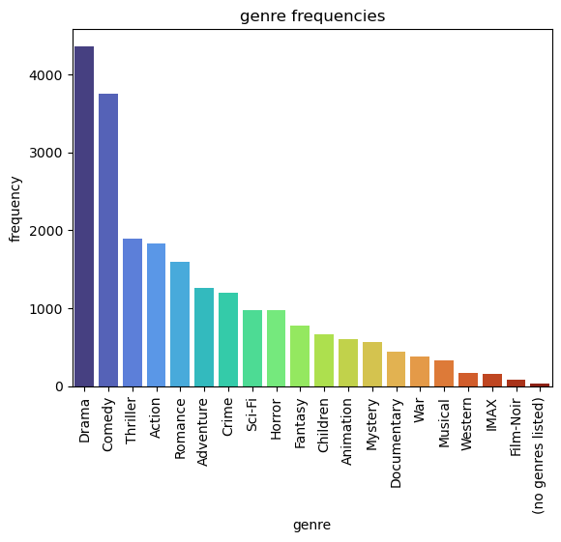
3. MOVIE RECOMMENDER SYSTEM
>
TOOLS AND TECHNIQUES
EXPLORATORY DATA ANALYSIS
Genre Frequencies
I checked the genres of movies and grouped them together using the Counter() function in python.
I noticed there are so many drama movies in those dataset. Comedy movies take up the second place in the list.
I genuinely didn’t expect there are more than 600 animated films. And that to in this small dataset!

Slide 41
3. MOVIE RECOMMENDER SYSTEM
>
TOOLS AND TECHNIQUES
DATA PRE-PROCESSING
Creating the Sparse matrix
In order to find the related movies, we use the user-movie matrix where the rows are users and columns are the movies.
The matrix is filled with the ratings given to each movie by the corresponding users.
We use scipy’s sparse function. We must provide the matrix with user_index and movie_index. We must also create four mapper.
The movie mapper
The inv_movie mapper
The user mapper
The inv_user mapper
After creating the matrix, we evaluate the sparsity of matrix. The sparsity is given by no of non-empty cells divided by total no of cells
The sparsity is 1.70, which is not bad for the matrix. If the value is negative or is above 5 or 6, then the results would be unexpected.

Slide 42
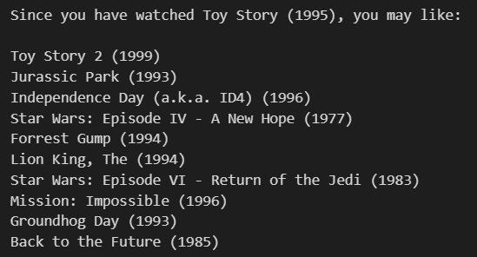
3. MOVIE RECOMMENDER SYSTEM
CREATING THE RECOMMENDER SYSTEM
The k-nearest neighbors algorithm
We use scikit-learn’s nearestneighbors function. Then we train the model with the sparse matrix. The model takes movie indices as vectors and finds the nearest movie indices in the matrix.
It returns all the similar movie indices for a given movie. We create a function to convert that movie index and then find the movie titles of all the ids that are found using the algorithm.
These are the recommendations for the movie ”Toy Story”.
You can see that most of the recommended movies are family movies and animated movies as well
Thus our recommender is working. But there is an issue with this. If a new member is added, it cannot recommend movie properly due to lack of information about them

Slide 43
3. MOVIE RECOMMENDER SYSTEM
CREATING THE RECOMMENDER SYSTEM
Content-based Filtering
That’s why we use Content- based filtering. In content-based filtering, the users and movies are allotted some ‘features’ which determines the likeability of the movie to the user.
If a movie likes horror movies and if a movie has horror in its genre, then the movie is recommended to him. This is widely used in most of streaming platforms
That’s why you have to select two or three favourite genres when signing up for any streaming platform.
We have to create a matrix with binary values for all the movie genres. If a movie has a genre I it, we mark it as 1 and other genres for that movie are marked 0.
These genres are now related with each other to find the cosine similarity of those genres.
This method takes in a movie index, find the simulated scores and returns the top 10 scores for the given movie
To make it simple, Its mostly like comparing the genres of all movies with all other movies.

Slide 44
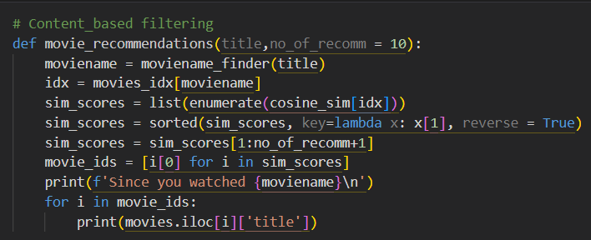
3. MOVIE RECOMMENDER SYSTEM
CREATING THE RECOMMENDER SYSTEM
Content-based Filtering
Well, we cannot remember every movieId in the dataset. Here’s where we use fuzzywuzzy. A python library that finds the most closest match for the word we are searching for.
It takes a list of all the movie titles, then it will compare your input with all titles and pick the n best matching names.
I created a function to convert the title into movie index, and then find recommendations and then convert the recommended movies’ indices back to titles. The result is given in the next slide.

Slide 45
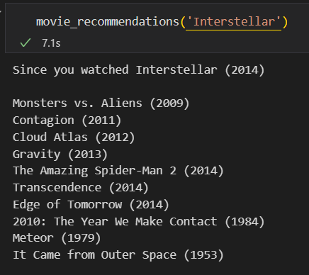
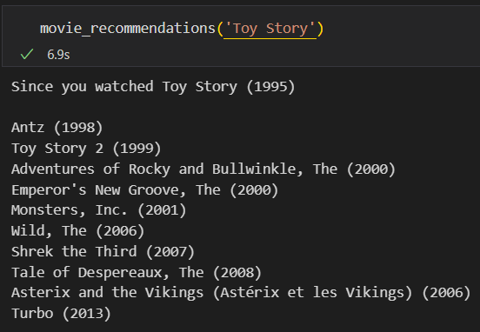
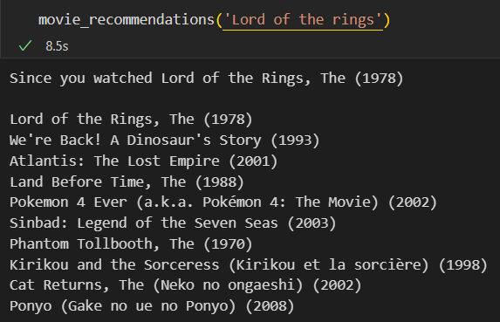
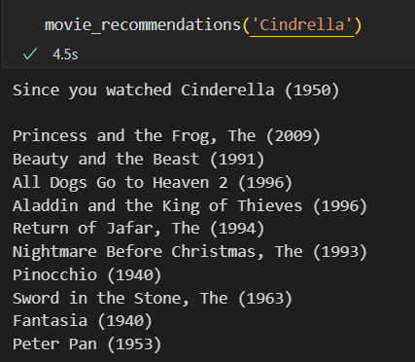

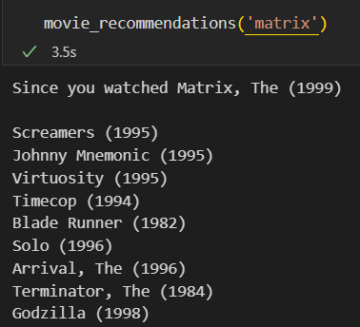
3. MOVIE RECOMMENDER SYSTEM
RESULTS

Slide 46
DATA ANALYST AND ANALYTICS INTERNSHIP
PROJECTS SUBMITTED:
1. SUPERMART GROCERY SALES ANALYSIS
2. COMPANIES VALUATION ANALYSIS
3. MOVIE RECOMMENDER SYSTEM
RESOURCES AND REFERENCES
I would greatly thank ‘Toronto Machine Learning’ whose webinar featuring ‘Jill Cates’, helped me a lot to finish this movie recommender system
I also referenced many statistical pages on youtube for understanding the concepts which were complex
All the code and the project is available in my github page. I will provide the link below.
The github repository contains the Jupyter notebook file which you can refer to later. And no extra csv files were exported from this project
The Movies Recommender System github repository link: click here to view the repository

Slide 47
DATA ANALYST AND ANALYTICS INTERNSHIP
PROJECTS SUBMITTED:
1. SUPERMART GROCERY SALES ANALYSIS
2. COMPANIES VALUATION ANALYSIS
3. MOVIE RECOMMENDER SYSTEM
These are the projects I had submitted for my internship in Unified Mentor Pvt. Ltd.

Slide 48
THANK YOU

